Slide 1

Variables in Python

Slide 2
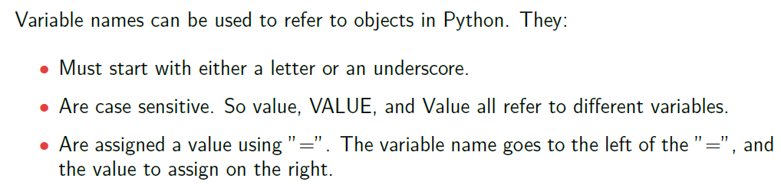
Variable Names

Slide 3
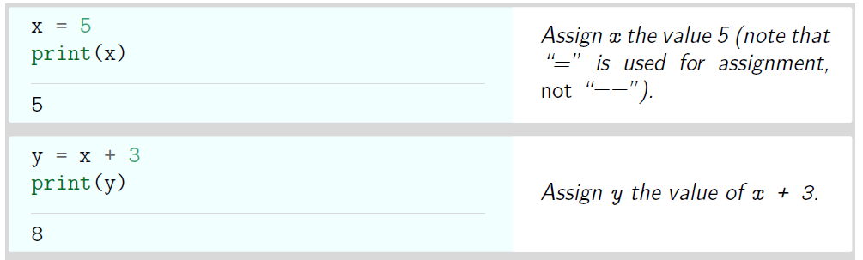
Variable Names

Slide 4
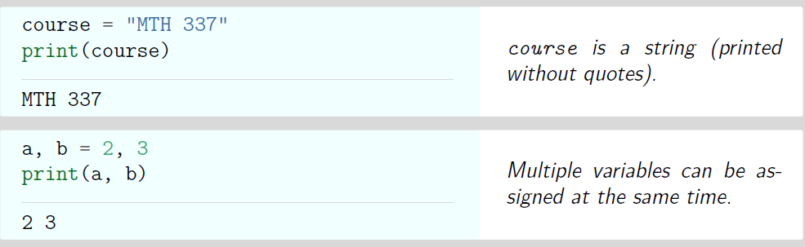
Variable Names

Slide 5
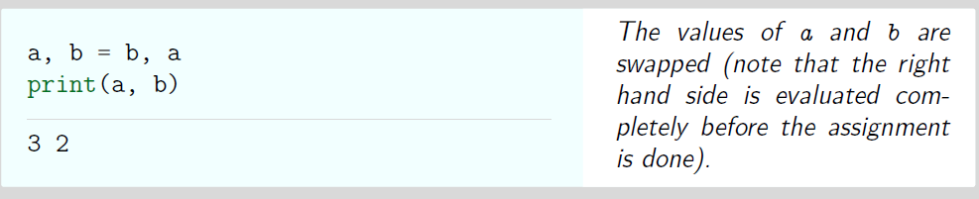
Variable Names

Slide 6
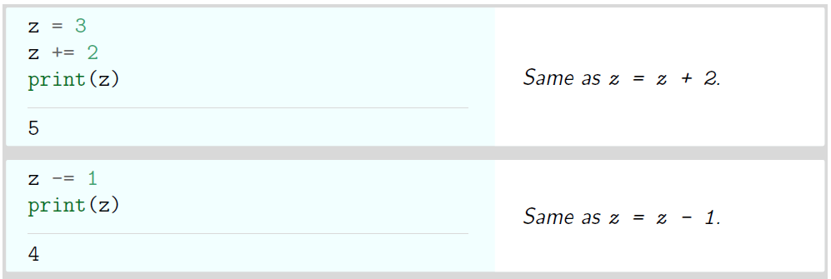
Variable Names

Slide 7
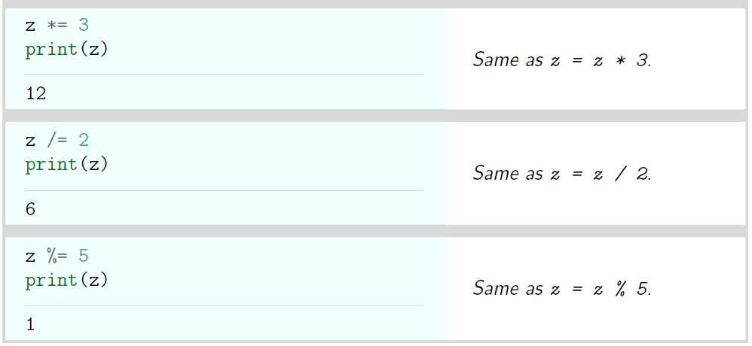
Variable Names

Slide 8
Thank You

